Slide 1

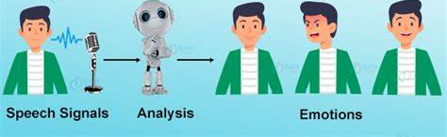
Speech Emotion Recognition using Deep Learning Algorithms

Slide 2
Authors
Dr. T. Sampath Kumar - t.sampathkumar@sru.edu.in
Anugam Saikiran - saikirananugam@gmail.com
Irukulla Apoorva – irukullaapoorva@gmail.com
Gaddam Huldah grace – huldahgraceg@gmail.com
Meghana Daddanala – meghanadaddanala@gmail.com
Anugam Uday kiran – anugamudaykiran@gmail.com

Slide 3
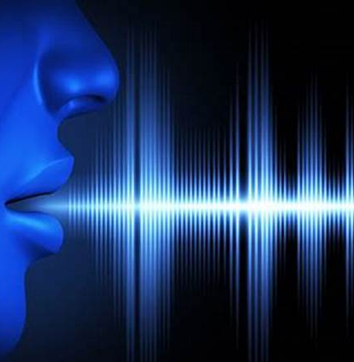
Problem statement
The objective of this project is to design, develop, and evaluate a deep learning-based system for Speech Emotion Recognition .
The system should be capable of accurately recognizing and classifying emotional states from audio recordings of human speech.

Slide 4

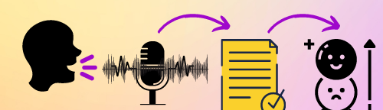
PROPOSED METHODOLOGY DATA SET:
The Ravdness dataset is downloaded from Kaggle. There are 7356 files totaling 24.8 GB in the Ryerson Audio-Visual Database of Emotional Speech and Song (RAVDESS).
The database comprises 24 professional actors (12 females and 12 males), each of whom reads two lexically related phrases with a neutral North American accent.
Both music and speech contain calm, joyful, sad, angry, terrified, surprise, and disgust expressions.

Slide 5
Data Preprocessing:
Steps for Data Preprocessing: Masking:
Initializing Mask: Initialize an empty list called a mask to store Boolean values for keeping or discarding each audio sample.
Calculating Absolute Values: Calculate absolute values of audio data using Pandas series function to capture overall amplitude.
Rolling Mean Calculation: Compute rolling mean of absolute values over a specified window using the Pandas rolling function.
Threshold Check and Mask Generation: Iterate over mean values, appending True to the mask list if the value exceeds a threshold (indicating main audio voice), and False otherwise.
Applying the Mask: Apply the generated mask as a filter to retain relevant audio portions while discarding unwanted segments.
Outcome:
The generated mask filters out unnecessary empty voices or noise, leaving the main audio voice intact.
The application of this mask facilitates effective voice cleaning, enhancing data quality for subsequent analysis and model training.

Slide 6
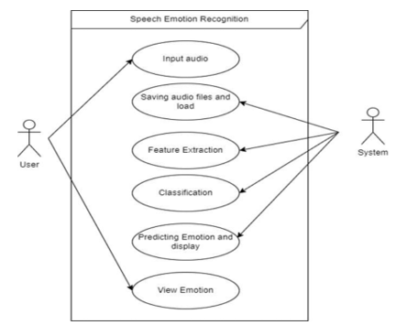
Use Case Diagram:
A use case diagram is a form of UML (Unified Modelling Language) diagram that illustrates the actors, use cases, and connections between them that make up a system's functionality. The interaction between the system and the user

Slide 7
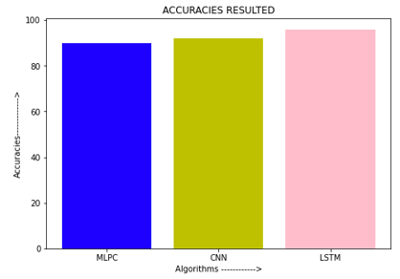
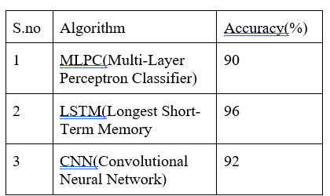
Models used:
Each algorithm is represented by a colored bar, with MLPC shown in blue, CNN in yellow, and LSTM in pink. The plot provides a clear and concise visualization of the accuracy results, allowing for easy comparison between the algorithms. By examining the bar heights, it is evident that LSTM achieved the highest accuracy

Slide 8
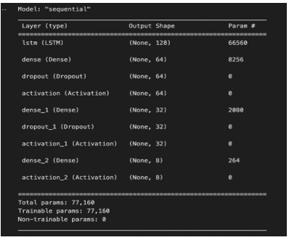
Longest Short-term Memory (LSTM)
LSTM models excel at capturing such long-range dependencies by selectively storing and retrieving information from past time steps.
By modeling the temporal dynamics of emotional expressions, LSTMs can learn to extract relevant features and patterns from the input audio sequences.
The ability of LSTMs to capture subtle variations and dependencies in speech signals has made them a popular choice in speech emotion recognition.
They can be trained on labeled datasets to classify various emotional states, enabling applications such as emotion-aware human-computer interfaces, sentiment analysis in call centers, and affective computing research.

Slide 9
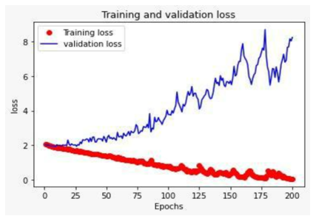
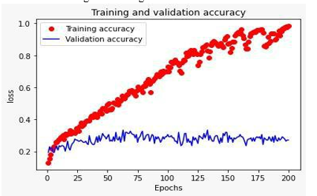
It is a graph displaying training and validation accuracy where epochs are taken on X-axis and loss is taken on Y-axis. Here training accuracy is represented by a red dot and validation accuracy is represented by a blue line

Slide 10
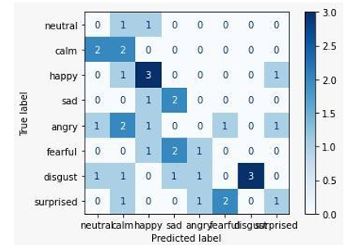
Confusion Matrix:
The above figure displays a confusion matrix, it visualizes and summarizes the performance of a classification algorithm where the Predicted label is on the x-axis and the True label is on the y-axis.

Slide 11
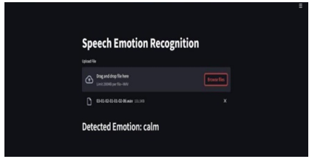
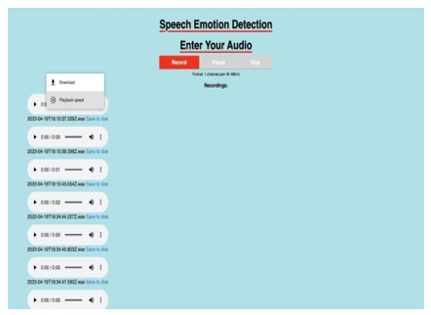
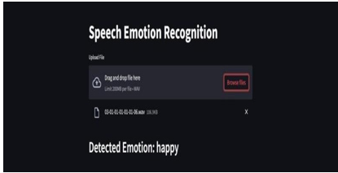
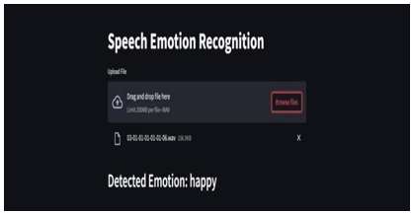
RESULTS:

Slide 12
CONCLUSION
Speech emotion recognition using deep learning holds significant potential across various applications in our daily lives.
The combination of deep learning algorithms and speech emotion recognition contributes to a more empathetic and responsive technological landscape.
As technology advances, the accuracy and effectiveness of speech emotion recognition systems are likely to improve, leading to even broader and more impactful applications.
Future research and development in this field can further refine existing models, explore novel architectures, and enhance the robustness of emotion recognition across diverse contexts and demographics.
This concludes the powerful role of speech emotion recognition using deep learning and its potential impact on various aspects of our lives.

Slide 13
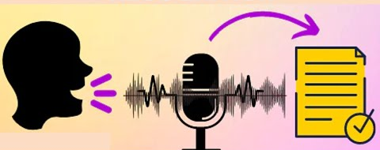

Thank You

